Slide 1

Topology-aware Parallel Data Processing
Paris Koutris
joint work with Spyros Blanas, Tasos Sidiropoulos, Xiao Hu

Slide 2
research in the group
Efficient Data Analytics
smart materialization techniques [talk by Shaleen]
fast analytics with Datalog [talk by Zhiwei]
Uncertain Data
consistent query answering [talk by Xiating]
certified robustness for ML tasks
Data Pricing
Parallel Data Processing
Topology-aware data processing [this talk!]

Slide 3
motivation
To scale data processing we need more cores
Both theory and practice assume that everything is homogeneous and the topology is uniform
Can we leverage network topology to make data processing faster?

Slide 4
topologies in the wild
trees
planar graphs
high-radix
star
grid
fat tree
2D-torus
macro-level: datacenters, clusters
micro-level: on-chip interconnect

Slide 5
prior models
Parallel models (MPC, BSP, PRAM) typically assume that everything is uniform:
every node can compute
every node has the same processing power/memory
every node can talk to any other node with the same cost

Slide 6
the model: network
The topology is modeled by a directed graph G
compute nodes: store data + perform computation
v₀
v₂
1
1
1
2
1
1
2
1
1
1
v₁
v₃
each link e is associated with bandwidth w_{e}

Slide 7
the model: computation
the input data is initially distributed across the compute nodes
an algorithm proceeds in sequential rounds
at every round:
the compute nodes perform local computation
global communication to exchange data

Slide 8
the model: cost
cost = cost (round 1) + cost (round 2) + …
Y_{i}(e) = data (in bits) that crosses link e during round i
cost (round i) = max_{e} | Y_{i}(e)| / w_{e}
The cost of each round is the cost of transferring data through the most bottlenecked link

Slide 9
joins with network interference
one link is slower than the others
Compute R join S
N = |R| +|S|
p compute nodes
each compute node holds 1/p data
uniform hashing (topology-oblivious)
cost = N/ (p × w_{slowest})
hashing with probability proportional to bandwidth
cost = N/ (w₁ + … w_{p})

Slide 10
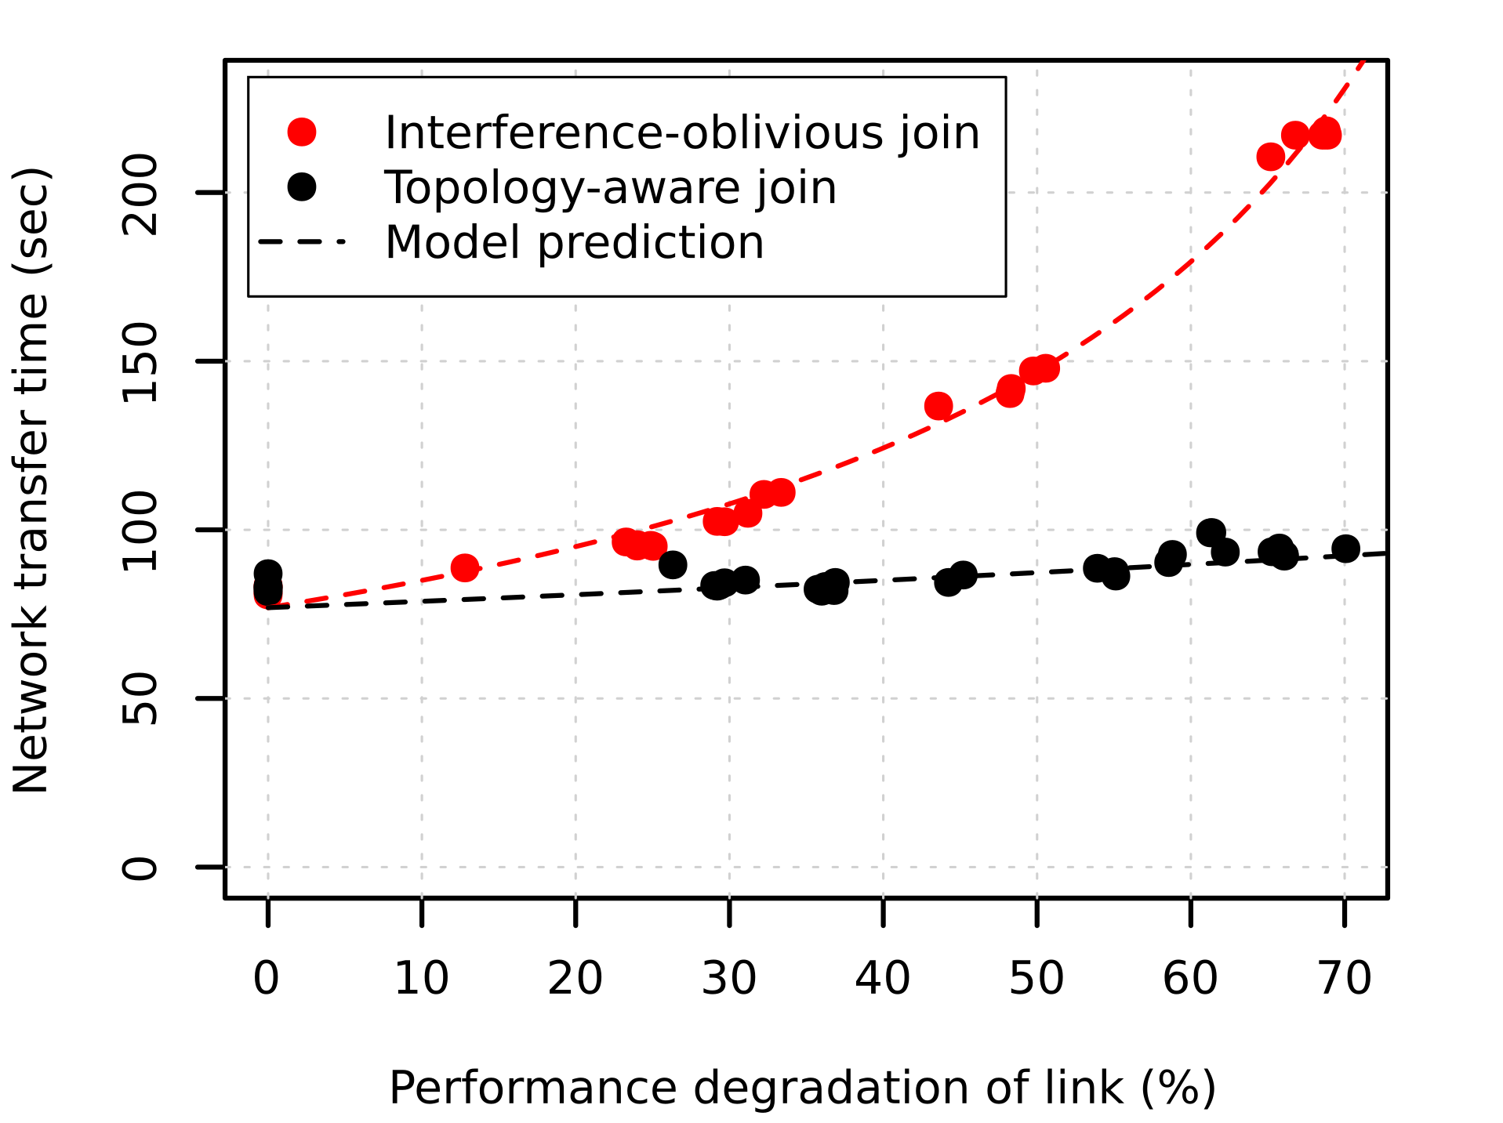
joins with network interference
The topology-aware join is more than 2× faster than the interference-oblivious join with high interference
Model is accurate!
2×

Slide 11
algorithmic results
We have designed (almost) optimal algorithms for:
aggregation
sorting
set intersection
cartesian product
*Our results are restricted to symmetric tree topologies
special cases for joins

Slide 12
future work
What is the optimal design for algorithms for parallel joins in complex topologies?
How do we discover topologies in the cloud?
How do we take latency into account?
Can we design an optimal topology for data processing given constraints?

Slide 13
summary
By leveraging network topology, we can design and implement better data processing algorithms
[CIDR 2020] Topology-aware Parallel Data Processing: Models, Algorithms and Systems at Scale
[PODS 2021] Algorithms for a Topology-aware Massively Parallel Computation Model

